Slide 1
Understanding Efficiency in Data Structures
Atique Zafar

Slide 2
What is Efficiency?
Definition: Efficiency refers to how well a data structure performs in terms of:
  Time Complexity → Speed of operations.
  Space Complexity → Memory usage.
Goal: Minimize time and memory for given operations.

Slide 3
Big-O Notation Overview
Definition of Big-O
Big-O notation is a mathematical way to describe the upper bound of an algorithm’s running time or space requirement as the input size n grows.
It tells us how the algorithm scales, not the exact time.
Example:
  If an algorithm is O(n), doubling the input size roughly doubles the time.
  If it’s O(log n), doubling input size adds only a small extra time.
Notes:
The upper bound in Big-O notation means the worst-case scenario for how long an algorithm will take (or how much space it will use) as the input size grows.
It’s like saying:
“No matter what happens, the algorithm will never take longer than this rate of growth.”
Example:
For linear search in an array of size n, the worst case is checking every element → O(n).
For binary search, even in the worst case, it only takes about log₂(n) steps → O(log n).
So, upper bound = maximum growth rate of time or space as input increases.
It helps us guarantee performance even in the most difficult cases.

Slide 4
Common Complexity Classes
O(1) – Constant Time
  Operation takes the same time regardless of input size.
  Example: Accessing an element in an array by index.
O(log n) – Logarithmic
  Time grows slowly as input increases.
  Example: Binary search in a sorted array.
O(n) – Linear
  Time grows proportionally with input size.
  Example: Searching in an unsorted linked list.
O(n log n) – Log-linear
  Common in efficient sorting algorithms (Merge Sort, Quick Sort).
O(n²) – Quadratic
  Time grows very fast; usually nested loops.
  Example: Bubble Sort.

Slide 5
Efficiency Table
Data Structure | Access | Search | Insert | Delete
Array | O(1) | O(n) | O(n) | O(n)
Linked List | O(n) | O(n) | O(1) | O(1)
Stack | O(n) | O(n) | O(1) | O(1)
Queue | O(n) | O(n) | O(1) | O(1)
Hash Table | O(1) | O(1) | O(1) | O(1)
BST (Balanced) | O(log n) | O(log n) | O(log n) | O(log n)
Heap | O(n) | O(n) | O(log n) | O(log n)

Slide 6
Real-World Examples
Array → Student roll numbers (fast index access).
Linked List → Music playlist (easy add/remove).
Stack → Undo feature in text editors.
Queue → Printer job scheduling.
Hash Table → Dictionary lookups (word → meaning).
BST → Sorted phone contacts.
Heap → Task scheduling (priority queue).

Slide 7
Importance in Data Structures
Every data structure has different operation complexities:
  Arrays → Fast access, slow insertion.
  Linked Lists → Fast insertion, slow search.
  Hash Tables → Almost constant time for search and insert.
Understanding Big-O helps you pick the right structure for your problem:
  If you need fast search, use Hash Table or Balanced BST.
  If you need frequent insertions, use Linked List.

Slide 8
What is Time Complexity?
Time Complexity measures how the running time of an algorithm grows as the size of the input (n) increases.
It does not give the exact time in seconds; instead, it shows the rate of growth.
Expressed using Big-O notation (e.g., O(1), O(n), O(log n)).

Slide 9
How Do We Calculate It?
Count the number of basic operations (like comparisons, assignments) as a function of n.
Focus on the dominant term (ignore constants and lower-order terms).
Express in Big-O notation.

Slide 10
Example
Example 1: Array Access
int x = arr[5];
  This takes constant time, regardless of array size → O(1)
Example 2: Linear Search
  for (int i = 0; i < n; i++) {
  if (arr[i] == key) return i;
  }
  In worst case, loop runs n times → O(n).
Example 3: Nested Loop
  for (int i = 0; i < n; i++) {
  for (int j = 0; j < n; j++) {
  // some operation
  }
  }
  Outer loop runs n times, inner loop runs n times → O(n²).

Slide 11
Step-by-Step Time Complexity Calculation
#include <iostream>
using namespace std;
int linearSearch(int arr[], int n, int key) {
for (int i = 0; i < n; i++) {
if (arr[i] == key) {
return i; // Found
}
}
return -1; // Not found
}
int main() {
int arr[] = {10, 20, 30, 40, 50};
int n = sizeof(arr) / sizeof(arr[0]);
int key = 40;
int result = linearSearch(arr, n, key);
if (result != -1)
cout << "Element found at index " << result << endl;
else
cout << "Element not found" << endl;
return 0;
}
Input size: n (number of elements in the array).
Operations:
  The loop runs up to n times in the worst case.
  Each iteration does:
    Comparison arr[i] == key → O(1)
    Possible return → O(1)
Worst Case:
  Key is not found → loop runs n times.
  Total operations ≈ n * O(1) → O(n).
Best Case:
  Key is at first position → only 1 comparison → O(1).
Average Case:
  Key is somewhere in the middle → about n/2 comparisons → still O(n) (we ignore constants).

Slide 12
The Problem
Imagine you need to find a number in a list of 1 million values.
Two options:
Search from start to end (Linear Search)
Use a smarter method like Binary Search Tree (BST)
Which one sounds faster?

Slide 13
What is a BST?
Binary Tree with the following rule:
  Left Child < Parent
  Right Child > Parent
Example:
50
/ \
30 70
/ \ / \
20 40 60 80
Helps quickly eliminate half of the tree on each comparison

Slide 14
Time Complexity Comparison
Operation | Linear List | BST (Balanced)
-------------- |---------------|----------------
Search | O(n) | O(log n)
Insertion | O(1)/O(n)| O(log n)
Deletion | O(n) | O(log n)
BST is much faster for large datasets (if balanced)

Slide 15
Real-World Analogy
Linear Search: Checking every door in a hotel to find your friend
BST: Asking at the front desk which floor/room they're on, narrowing down quickly

Slide 16
What Happens If BST is Not Balanced?
Example of sorted insertion:
10
\
20
\
30
\
40
Acts like a Linked List
Time Complexity becomes O(n)

Slide 17
How to Keep BST Balanced?
Use Self-Balancing Trees:
- AVL (Adelson-Velsky and Landis) Tree

Slide 18

Balance Factor Concept
balance factor = height(left subtree) - height(right subtree)
valid balance factor values: -1, 0, 1
node becomes unbalanced if balance factor is beyond these values

Slide 19
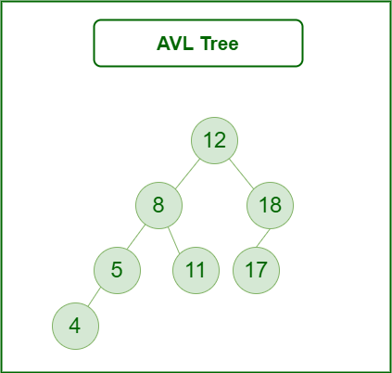
Example of an AVL Tree
Every AVL tree is also a Binary Search Tree (Left subtree values Smaller and Right subtree values greater for every node), but every BST is not AVL Tree.

Slide 20
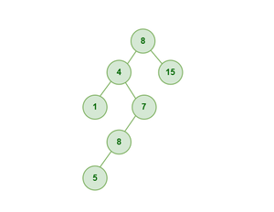
Example of a BST which is NOT AVL

Slide 21
Why AVL Trees?
ensures logarithmic time complexity
maintains sorted structure with balance
faster search, insert, and delete than unbalanced BST

Slide 22
Types of Rotations
single right rotation (LL case)
single left rotation (RR case)
left-right rotation (LR case)
right-left rotation (RL case)

Slide 23
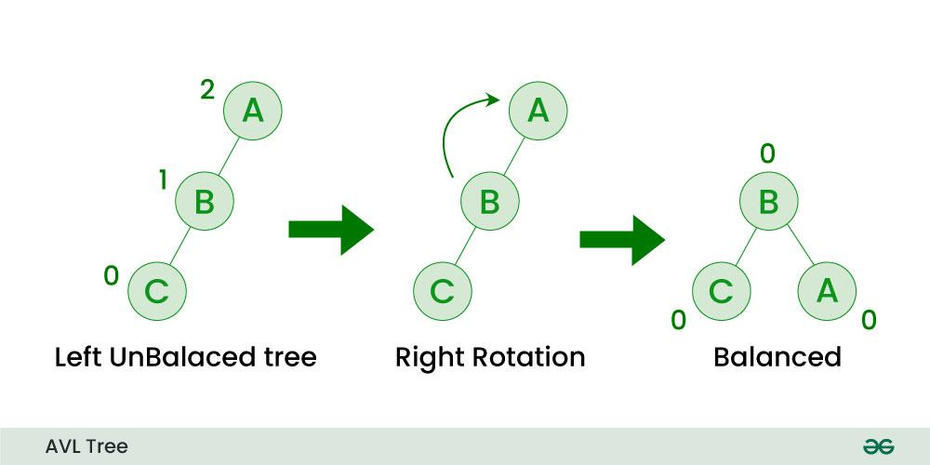
Single Right Rotation (LL case)
If a node is added to the left subtree of the left subtree, the AVL tree may get out of balance, we do a single right rotation.

Slide 24
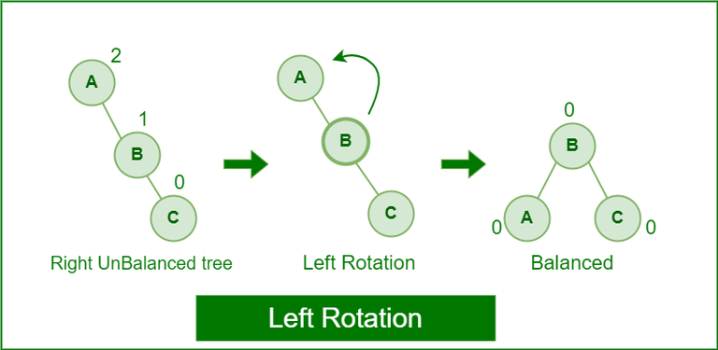
Single Left Rotation (RR case)
When a node is added into the right subtree of the right subtree, if the tree gets out of balance, we do a single left rotation.

Slide 25
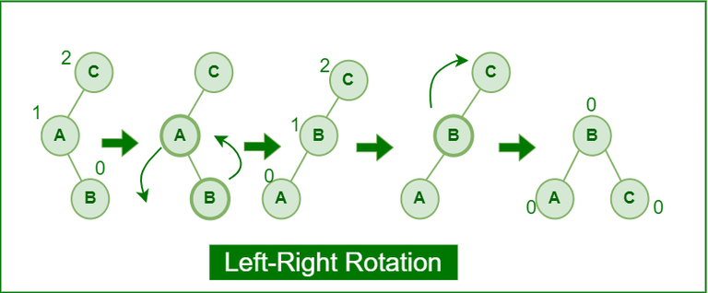
Left-Right Rotation: (LR case)
A left-right rotation is a combination in which first left rotation takes place after that right rotation executes.

Slide 26
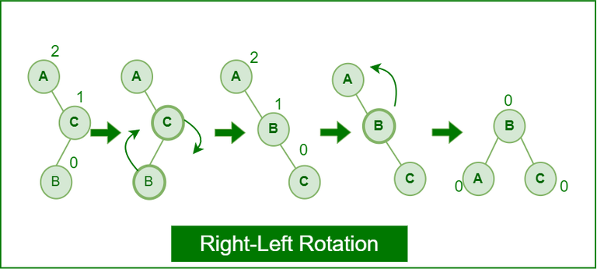
Right-Left Rotation: (RL case)
A right-left rotation is a combination in which first right rotation takes place after that left rotation executes.

Slide 27
Question in SP-14 Terminal Exam

Slide 28
Class Exercise
In a software system, an AVL tree is used to efficiently manage a dataset that needs frequent insertions and lookups. To ensure optimal performance, the AVL tree must remain balanced after each insertion. You are tasked with helping the system maintain its balance by constructing the AVL tree for the following sequence of keys and applying necessary rotations:
Keys to Insert: 12, 5, 30, 18, 7, 25, 40
Tasks: 1. Construct the AVL tree step by step, showing the tree after each key insertion.

Slide 29
Quiz#2: is mapped with CLO–2: Use non-linear data structures to solve computing problems
Pakistan International Airport is developing a computer simulation of air-traffic control, which handles events such as landings and take-offs. Each event can be defined by an eventId (string) and a timeStamp (int). The timeStamp denotes when the event occurs.
The simulator needs to perform efficiently the following two operations using a Binary Search Tree (BST):
  Insert a new event with a given timeStamp (i.e., add a future event). (3 Marks)
  Get the event with the smallest timeStamp (i.e., determine the next event to process). (2 Marks)
Write C++-style pseudocode for your solution.
Keep in mind that the number of flights is not fixed, and the application is time-sensitive, especially with respect to finding the next event.

Slide 30
// Structure to represent an event
struct Event {
string eventId;
int timeStamp;
Event* left;
Event* right;
};
// Root pointer for BST
Event* root = NULL;
// (a) Insert a new event in BST based on timeStamp
Event* insertEvent(Event* node, string id, int time) {
if (node == NULL)
return createEvent(id, time);
if (time < node->timeStamp)
node->left = insertEvent(node->left, id, time);
else
node->right = insertEvent(node->right, id, time);
return node;
}
// Function to create a new Event node
Event* createEvent(string id, int time) {
Event* newNode = new Event();
newNode->eventId = id;
newNode->timeStamp = time;
newNode->left = newNode->right = NULL;
return newNode;
}
// (b) Get the event with the smallest timeStamp (leftmost node)
Event* getNextEvent(Event* node) {
if (node == NULL) {
cout << "No upcoming events!" << endl;
return NULL;
}
Event* current = node;
while (current->left != NULL)
current = current->left;
return current; // smallest timeStamp event
}
Notes:
int main() {
root = insertEvent(root, "Landing_PIA101", 1200);
root = insertEvent(root, "TakeOff_PIA202", 1100);
root = insertEvent(root, "Landing_PIA303", 1230);
Event* next = getNextEvent(root);
cout << "Next Event: " << next->eventId
<< " at " << next->timeStamp << endl;
return 0;
}

